Slide 1
FLOOD MONITORING AND EARLY WARNING
DEPARTMENT OF COMPUTER SCIENCE AND ENGINEERING
TEAM NAME : Proj_224785_Team_2 TEAM MEMBERS :
1. RAMKUMAR.N(113321104079)
2.RANJITH.Y(113321104080)
PHASE 5 3.SANTHOSH.K(113321104085)
4.SANTHOSH.N(113321104086)

Slide 2
INNOVATION:
Internet of Things (IoT) Sensors:
The use of a broader range of IoT sensors, including those for soil moisture, water quality, and river levels, can provide a more comprehensive view of flood risk factors.
IoT devices can be more widely distributed, especially in remote or vulnerable areas.
Blockchain for Data Verification:
Blockchain technology can be employed to ensure the integrity and authenticity of flood sensor data, preventing data tampering and enhancing trust in the information provided.
Citizen Science and Crowdsourcing:
Engaging the public through mobile apps and social media to report flooding incidents in real time can provide additional data for early warning systems.
Crowdsourced data can complement official monitoring efforts.
Flood Modeling and Simulation:
Implementing high-resolution hydrodynamic and flood modeling to simulate flood scenarios, allowing for more accurate predictions of flood extent and impact.
Satellite Remote Sensing:
Satellite data can provide valuable information on rainfall, water levels, and flood extents, aiding in the monitoring and early warning process.
Early Warning Communication Channels:
Utilize a combination of communication channels, such as social media, mobile apps, and instant messaging services, to reach a wider audience with flood alerts.
Implement multilingual and accessible alerting systems to ensure

Slide 3
PROJECT OBJECTIVES:
1.Early Detection and Warning:
Provide early and accurate detection of meteorological conditions and rising water levels to issue timely flood warnings.
2.Risk Assessment:
Evaluate the potential impact of flooding on communities, infrastructure, and the environment.
3.Public Safety:
Protect the lives of residents in flood-prone areas by providing clear and effective warnings and evacuation information.
4.Property Protection:
Minimize damage to homes, businesses, and infrastructure through timely flood warnings and risk communication.
5.Infrastructure Resilience:
Support the design and construction of resilient infrastructure that can withstand or mitigate flood impacts.
6.Emergency Response Coordination:
Facilitate the coordinated response of emergency services and agencies during flood events.
7.Community Preparedness:
Educate and prepare communities for flood risks, enabling them to respond.

Slide 4
PROJECT REQUIREMENTS:
1.Project Scope and Objectives:
Define the specific goals and objectives of the system, including the geographical area it will cover, the types of floods it will address (e.g., riverine, flash floods, coastal), and the level of early warning desired.
2.Stakeholder Identification:
Identify all stakeholders, including government agencies, local communities, emergency services, and NGOs, that will be involved in the project.
3.Budget and Funding Sources:
Specify the project budget, including funding sources and financial constraints.
4.Early Warning Criteria:
Set clear and specific criteria for issuing flood warnings, such as trigger thresholds for various parameters (e.g., river levels, rainfall intensity).
5.Sensor Deployment:
Define the number and types of sensors (water level sensors, rainfall gauges, weather stations, etc.) required and their locations.
6.Warning Dissemination:
Define the methods for disseminating warnings, including sirens, mobile apps, SMS alerts, radio, and television broadcasts.
7.Training:
Provide training for system operators, emergency responders, and community members on how to use the system effectively.

Slide 5
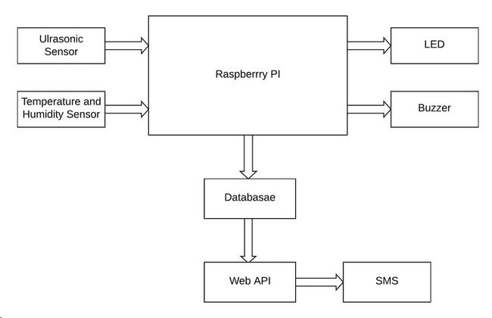
RASPBERRY PI INTEGRATION:

Slide 6
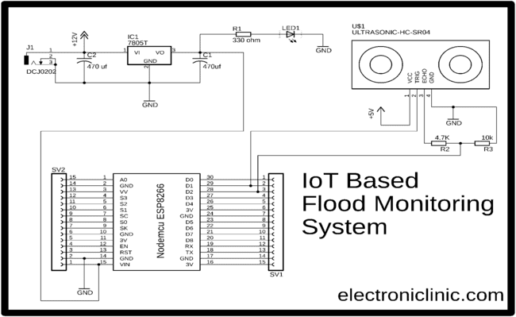
ARDUINO INTEGRATION:

Slide 7
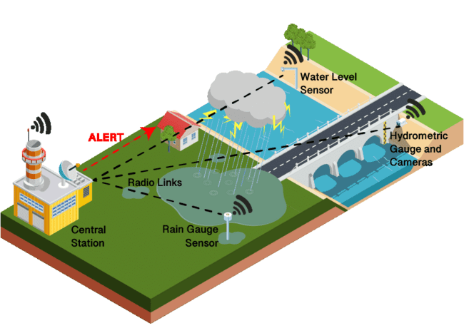
IOT SENSOR

Slide 8
CODE IMPLEMENTATION:
HARDWARE COMPONENTS: PYTHON SCRIPT DEVELOPMENT: PYTHON SCRIPT
1.Raspberry Pi 1.Setting Up the Central Server DEVELOPMENT FOR
2.Water Flow Sensor Environment CENTRAL SERVER:
3.Solenoid Valve 2.Data Reception
4.Wi-Fi Module 3.Data Storage 1.Importing Required
5.Power Supply 4.Data Visualization Libraries
5.Error Handling 2.Data Visualization
SOFTWARE COMPONENTS: 6.Testing 3.Data Processing and
1.MQTT 7.Control Logic Analysis
2.Python 8.Documentation 4.User Authentication
3.Cloud server 9.Power Management and Access control
5.Security Measures
6.Testing and
Debugging

Slide 9
MOBILE APP DEVELOPMENT : 1.Objectives 2.Market Research 3.Technology stack 4.Feature Set 5.Backend Development 6.Testing 7.IoT Integration 8.Security and Privacy 9.Visualization 10.User Testing

Slide 10
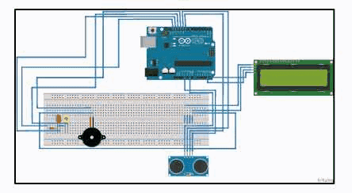
IMPLEMENTATION AND SIMULATION(Watch simulation video below):

Slide 11
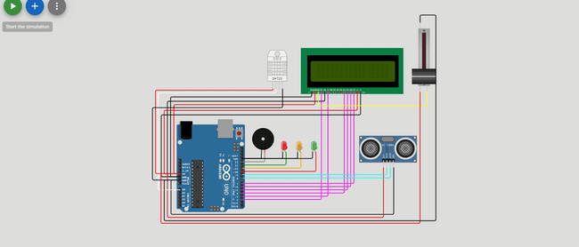

Slide 12
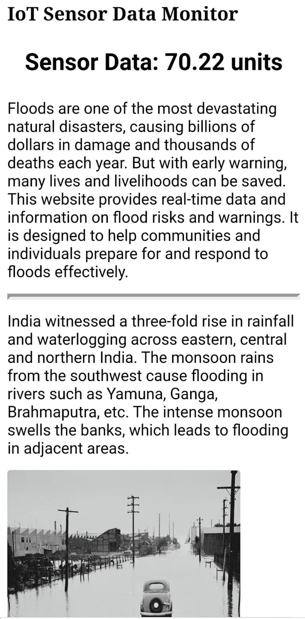
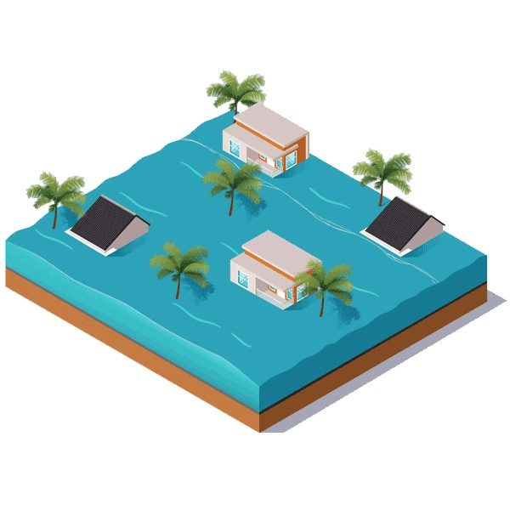
WEBSITE :
CLICK AND SEE THE WEBSITE:
https://flood-montioring.netlify.app/

Slide 13
CONCLUSION :
The development of a Flood Monitoring and Early Warning System is a critical endeavor to safeguard communities from the devastating effects of floods. By deploying advanced technology, data analysis, and community engagement, this project aims to create a robust system that can make a significant difference in reducing the impact of flood events and saving lives.

Slide 14


